Slide 1
IO Streams

Slide 2
Introduction
Java uses the concept of a stream to make I/O operation fast. The java.io package contains all the classes required for input and output operations.
Stream: A stream is a sequence of data. In Java, a stream is composed of bytes. It's called a stream because it is like a stream of water that continues to flow.
In Java, 3 streams are created for us automatically. All these streams are attached with the console.
1) System.out: standard output stream
2) System.in: standard input stream
3) System.err: standard error stream

Slide 3
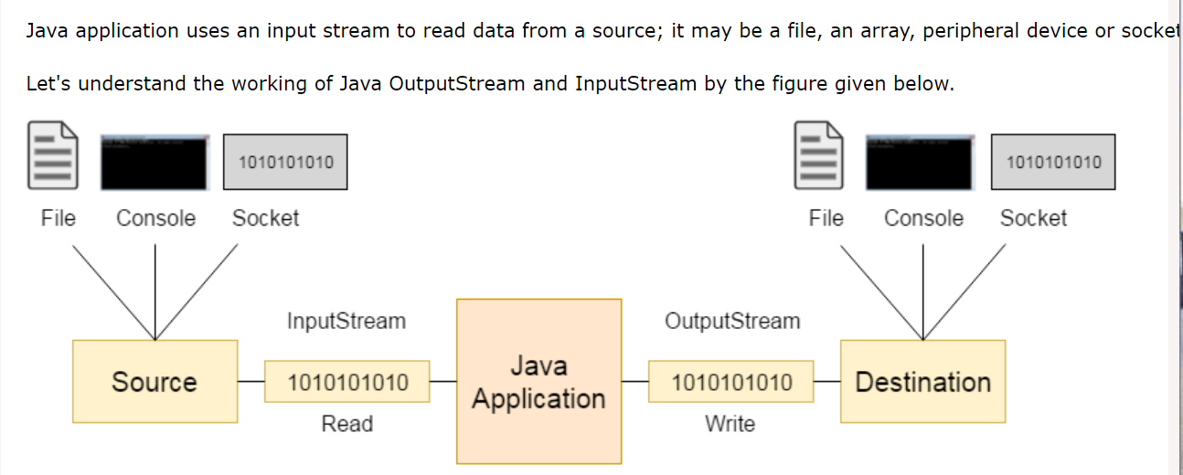
Introduction

Slide 4
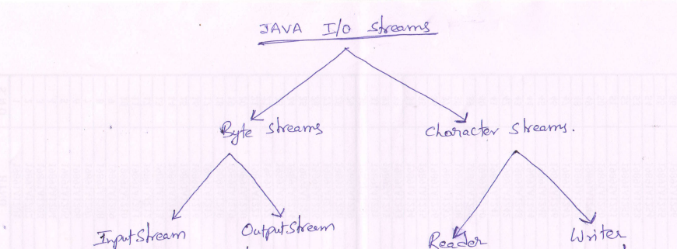
JAVA IO Streams Hierarchy

Slide 5
Byte Streams
OutputStream
Java application uses an output stream to write data to a destination; it may be a file, an array, peripheral device or socket.
InputStream
Java application uses an input stream to read data from a source; it may be a file, an array, peripheral device or socket.

Slide 6
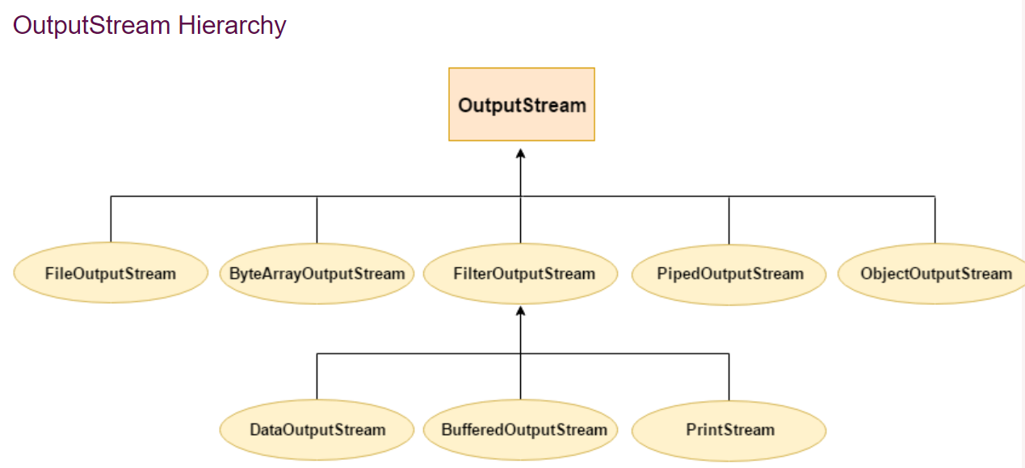

Slide 7
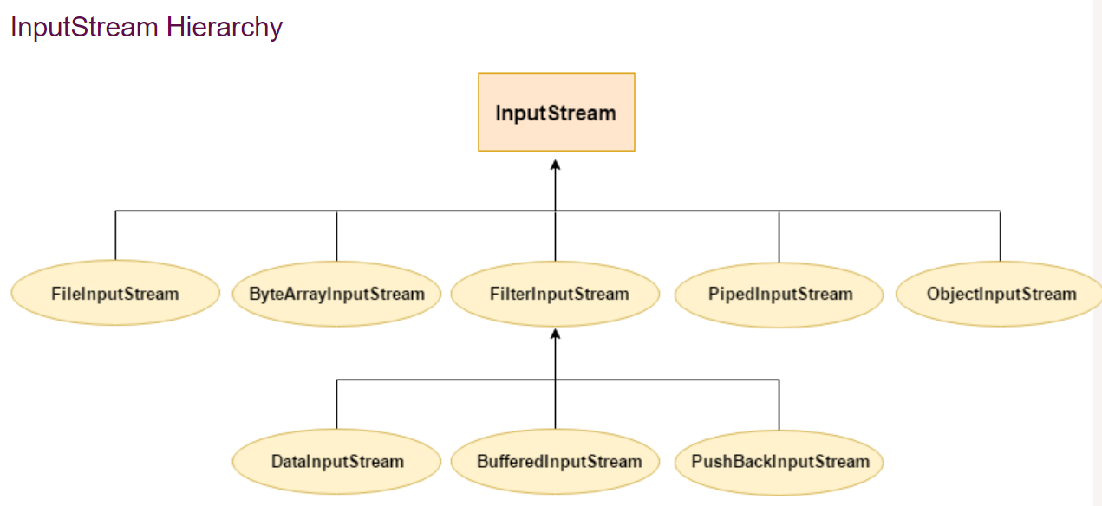

Slide 8
Character Streams
Character streams are defined within two class hierarchies, one for input and one for output:
The Writer class is the abstract superclass of all character output streams
The Reader class is the abstract superclass of all character input streams
These classes define the characteristics that are common to character input and character output streams, which are implemented in the concrete subclasses of each hierarchy.

Slide 9
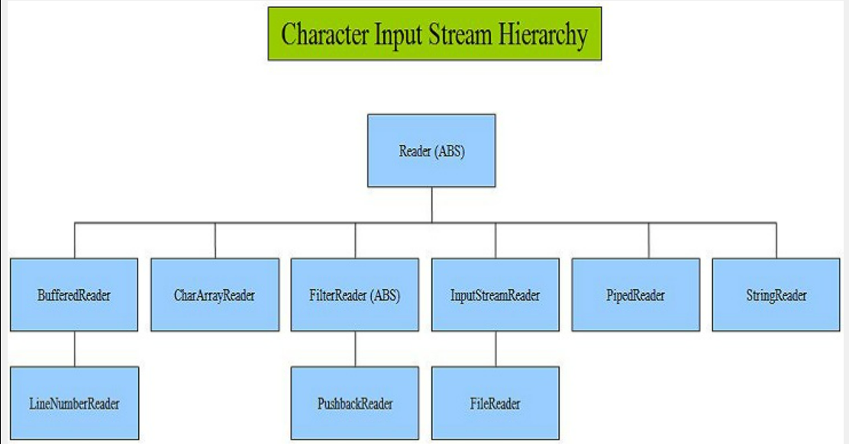

Slide 10
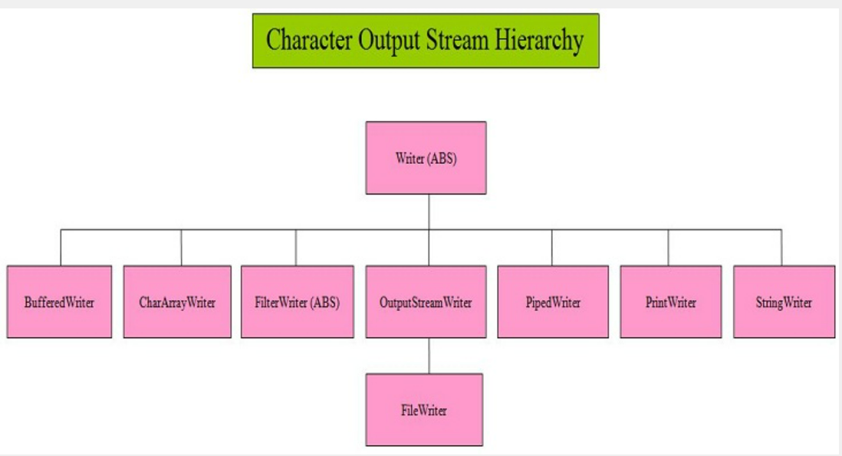

Slide 11
Java File Class
The File class is an abstract representation of file and directory pathname.
A pathname can be either absolute or relative.
The File class have several methods for working with directories and files such as
creating new directories or files
deleting and renaming directories or files
listing the contents of a directory etc.

Slide 12
Methods of File class
Modifier and Type | Method | Description
boolean | createNewFile() | It atomically creates a new, empty file named by this abstract pathname if and only if a file with this name does not yet exist.
boolean | canWrite() | It tests whether the application can modify the file denoted by this abstract pathname.String[]
boolean | canExecute() | It tests whether the application can execute the file denoted by this abstract pathname.
boolean | canRead() | It tests whether the application can read the file denoted by this abstract pathname.
boolean | isDirectory() | It tests whether the file denoted by this abstract pathname is a directory.

Slide 13
Methods of File class
boolean | isFile() | It tests whether the file denoted by this abstract pathname is a normal file.
String | getName() | It returns the name of the file or directory denoted by this abstract pathname.
String | getParent() | It returns the pathname string of this abstract pathname's parent, or null if this pathname does not name a parent directory.
Path | toPath() | It returns a java.nio.file.Path object constructed from the this abstract path.
File[] | listFiles() | It returns an array of abstract pathnames denoting the files in the directory denoted by this abstract pathname
boolean | mkdir() | It creates the directory named by this abstract pathname.

Slide 14
Java –RandomAccessFile
This class is used for reading and writing to random access file. A random access file behaves like a large array of bytes.
There is a cursor implied to the array called file pointer, by moving the cursor we do the read write operations.
If end-of-file is reached before the desired number of byte has been read than EOFException is thrown. It is a type of IOException.
This class is not derived from either InputStream or OutputStream.
Implemented DataInput&DataOutput interfaces.

Slide 15
RandomAccessFile class has implemented all the standard input & output methods which we can use for read/write operations with Random access files.
We can position the file pointer at a required position for read/write operations.
Access modes:
r - for read
w - for write
rw - for read and write
Positioning File Pointer:
void seek(long newpos) throws IOException
It moves the file pointer by number of bytes specified by the argument ‘newpos’ from the beginning of the file.

Slide 16
Java Console Class
The Java Console class is used to get input from console. It provides methods to read texts and passwords.
If you read password using Console class, it will not be displayed to the user.
The java.io.Console class is attached with system console internally. The Console class is introduced since 1.5
Java Console class declaration
The declaration for Java.io.Console class:
public final class Console extends Object implements Flushable

Slide 17
How to get the object of Console
System class provides a static method console() that returns the singleton instance of Console class.
public static Console console(){}
The code to get the instance of Console class.
Console c=System.console();
Singleton Class in Java:
A singleton class is a class that can have only one object (an instance of the class) at a time.
After first time, if we try to instantiate the Singleton class, the new variable also points to the first instance created.
So whatever modifications we do to any variable inside the class through any instance, it affects the variable of the single instance created and is visible if we access that variable through any variable of that class type defined.

Slide 18
Serialization
Process of writing state of an object to a byte stream. Saving the object in a persistant storage.
Only the objects that implement serializable interface can be serialized.
The serializable interface has no methods, it only indicates that the objects of this can be serialized.
If a class is Serializable, all of its sub classes are also serializable.
Transient attributes will not be serialized.
Static attributes also will not be serialized.

Slide 19
There may also be circular references within this object graph ie object x may contain reference to object y, and y may have references to back to x.
Objects may also contain references to themselves.
The object serialization and deserialization facilities have been designed to work correctly in these scenarios.
If you attempt to serialize an object at the top of the object graph, all of the referenced objects are recursively located and serialized.
At deserialization all these objects and their references are corectly restored.
It is legal to serialize an object of type that has a super type that does not implement Serializable interface.
At the time of deserialization jre invokes the constructors of those base classes which do not implement Serializable interface.
An object Serialized on one JVM can be successfully deserialized on another JVM

Slide 20
Autoboxing & Unboxing
Autoboxing: Converting a primitive value into an object of the corresponding wrapper class is called autoboxing. For example, converting int to Integer class. The Java compiler applies autoboxing when a primitive value is:
Passed as a parameter to a method that expects an object of the corresponding wrapper class.
Assigned to a variable of the corresponding wrapper class.

Slide 21
Unboxing: Converting an object of a wrapper type to its corresponding primitive value is called unboxing. For example conversion of Integer to int. The Java compiler applies unboxing when an object of a wrapper class is:
Passed as a parameter to a method that expects a value of the corresponding primitive type.
Assigned to a variable of the corresponding primitive type.

Slide 22
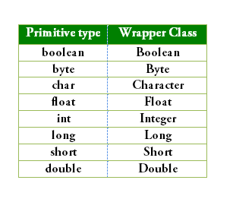
The following table lists the primitive types and their corresponding wrapper classes, which are used by the Java compiler for autoboxing and unboxing:
Example:
int i=10; //i is variable of type int
Integer j = new Integer(10); //j is a object of type Integer

Slide 23
Generics in Java
The Java Generics programming is introduced in J2SE 5 to deal with type-safe objects. It makes the code stable by detecting the bugs at compile time.
Before generics, we can store any type of objects in the collection, i.e., non-generic. Now generics force the java programmer to store a specific type of objects.
Syntax to use generic collection
ClassOrInterface<Type>
Example to use Generics in java
ArrayList<String>

Slide 24
Advantage of Java Generics
There are mainly 3 advantages of generics. They are as follows:
Type-safety: We can hold only a single type of objects in generics. It doesnt allow to store other objects. Without Generics, we can store any type of objects
Type casting is not required: There is no need to typecast the object. Before Generics, we need to type cast.
Compile-Time Checking: It is checked at compile time so problem will not occur at runtime. The good programming strategy says it is far better to handle the problem at compile time than runtime.

Slide 25
Enum
The Enum in Java is a data type which contains a fixed set of constants.
Examples:
It can be used for days of the week (SUNDAY, MONDAY, TUESDAY, WEDNESDAY, THURSDAY, FRIDAY, and SATURDAY)
Directions (NORTH, SOUTH, EAST, and WEST)
Season (SPRING, SUMMER, WINTER, and AUTUMN or FALL)
Colors (RED, YELLOW, BLUE, GREEN, WHITE, and BLACK) etc.
According to the Java naming conventions, we should have all constants in capital letters. So, we have enum constants in capital letters.

Slide 26
Enum (cont..)
The Java enum constants are static and final implicitly. It is available since JDK 1.5.
Enums are used to create our own data type like classes.
The enum data type (also known as Enumerated Data Type) is used to define an enum in Java.
Enum improves type safety
Enum can be easily used in switch
Enum can be traversed
Enum can have fields, constructors and methods
Enum may implement many interfaces but cannot extend any class because it internally extends Enum class

Slide 27
Enum (cont..)
Java compiler internally adds values(), valueOf() and ordinal() methods within the enum at compile time. It internally creates a static and final class for the enum.
The values() method returns an array containing all the values of the enum.
The valueOf() method returns the value of given constant enum.
The ordinal() method returns the index of the enum value.
Constructor of enum type is private. If you don't declare private compiler internally creates private constructor

